Slide 1

The Lean English Podcast
Episode 5: Systems Thinking
Part 2

Slide 2
Benefits to CLD
The main benefit of diagramming your company’s system is to find the leverage points that you will use to influence the system.
These lead to long-term solutions, as short-term thinking depends on linear causality.
Another benefit from CLD is that there are many systems that have already been diagrammed called Systems Archetypes.
Understanding archetypes may help you understand your business even better.
Notes:
Archetype: a typical example of something, or the original model of something from which others are copied: dictionary.Cambridge.org
When confronted with traffic congestion, you may drive faster to get to your destination. But as soon as you understand the system of roads, automobiles, bikes, traffic lights, congestion and construction, you will see that there is no benefit from buying a faster car.

Slide 3
System modeling
When you begin modeling, remember that it should serve a purpose, to understand the system you are trying to change.
Stop modeling when you understand it well enough to enact some change. If you don’t, you may fall into the trap of mapping systems that you do not influence.
Also, while understanding the system is an important first step, it is not the final activity.
Just as Value Stream Mapping by itself does not reduce process waste, system modeling does little if process improvement activities do not follow.

Slide 4
Causal loop diagramming
To understand the systems that you are trying to improve, it is useful to create Causal Loop Diagrams (CLD).
Just as process and value stream maps help us understand what we are doing, these maps help us understand the parts of a system that impact your outcomes.
There are 4 steps to Causal Loop Diagramming:
  Create Variable names
  Draw the links
  Label the Loop
  Talk through the Loop
Notes:
“Causal Loop Construction, The Basics” Colleen P. Lannon, Pegasus Classics

Slide 5
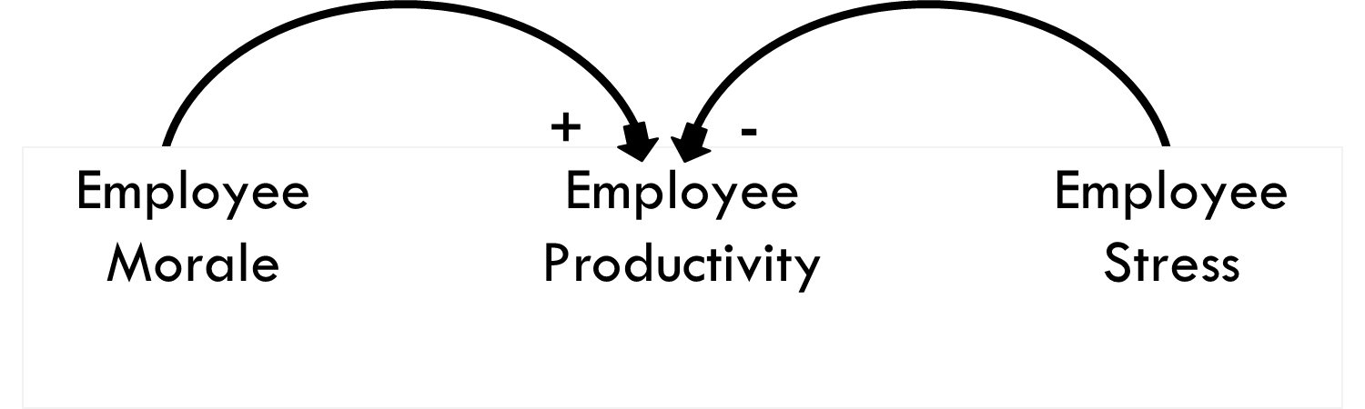
Influences on productivity
In this simple diagram, we see how two parts of a company’s system, morale and stress, influence a third part, productivity.
Morale has a reinforcing (+) influence, so as morale goes up or down, productivity goes up or down.
Stress has an inverse (-) influence, so as stress goes up or down, productivity does the opposite.

Slide 6
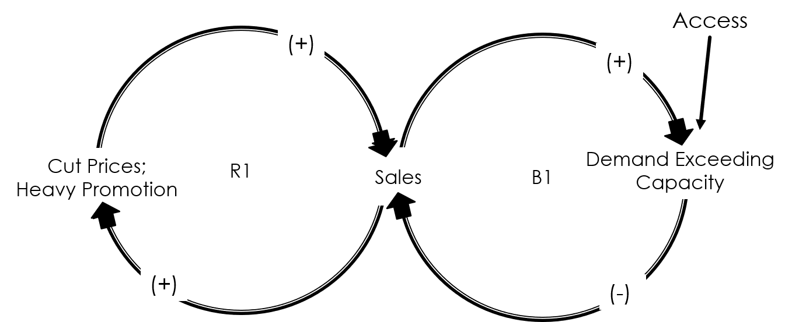
How to read a Systems Diagram
Here we see how Causal Loop Diagramming depicts non-linear relationships.
In this system, a company’s sales are reinforced by their pricing and marketing activities but subsequently balanced by their ability to meet demand.
Even though they promoted the product heavily, their lack of access drove sales down.
Notes:
Cause and effect are typically non-linear and often take time to be fully realized. This is because an action influences many variables, and each variable responds differently.

Slide 7
Purpose of Archetype study
Archetype: Wikipedia defines an archetype as “a universally understood symbol or term or pattern of behavior, a prototype upon which others are copied, patterned, or emulated.”
It is important to study System Archetypes so we can identify patterns of organizational behavior that lead us down predictable paths of limited growth or decreasing performance.

Slide 8
Using Systems Archetypes
Knowledge of Systems Archetypes can be used to benefit your organization in 2 ways:
Diagnostically – helping your manager understand patterns that are at work in your organization right now
Prospectively – the manager uses his understanding to foresee the problems he may have when he decides to implement change in the organization
It is best to prevent the pitfalls of these archetypes to prevent the organization from adopting bad habits in the first place.

Slide 9
Diagramming Archetypes
Each Archetype will have its own diagram that shows the relationship between efforts and results, actions and consequences.
From these diagrams, you understand the need for Systems Thinking which incorporates the theory that all actions are both a cause and an effect.
With Systems Thinking, it is easy to see how we can get trapped in vicious cycles.

Slide 10
10 Systems Archetypes
Limits to Growth – The Law of Diminishing Returns
Shifting the Burden – Treat the symptom, not the disease
Eroding Goals – Lower your aspirations to prevent failure
Escalation – Let’s enter an arms race
Success to the Successful – The rich get richer; the poor get poorer

Slide 11
10 Systems Archetypes
Tragedy of the Commons – The glue that keeps it together starts to come apart
Fixes that Fail – The Law of Unintended Consequences
Growth and Underinvestment – Why throw good money after bad?
Accidental Adversaries – Turning a friend into an enemy
Attractiveness Principle – Choosing which problem to address first

Slide 12
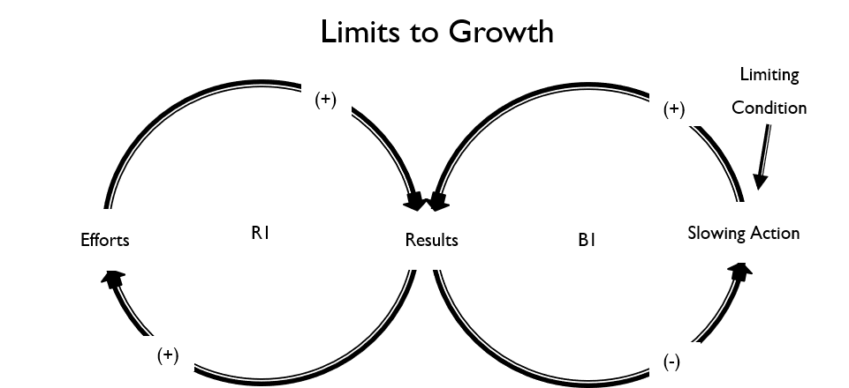
1. Limits to Growth
This is where a reinforcing dynamic is negated by a balancing dynamic. All efforts to progress are initially supported and reinforced, but eventually a balancing system counters the growth.
The leverage comes from identifying and removing the balancing dynamic, not increasing the reinforcing dynamic.

Slide 13
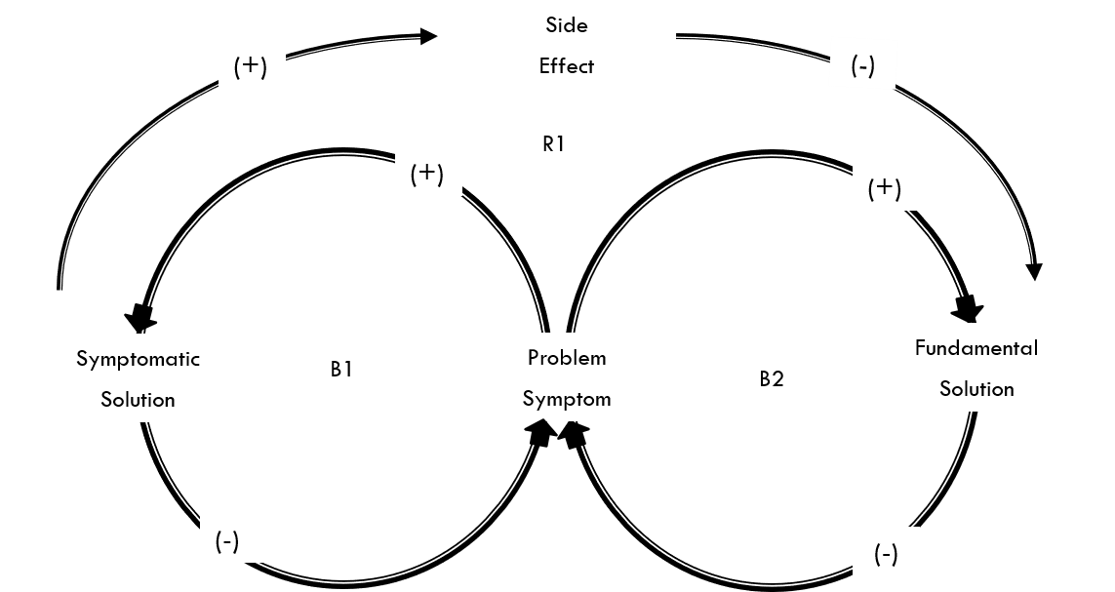
2. Shifting the Burden
This Archetype shows the tension between initiating a change to attack the symptom and a change that fixes the problem.
Often simply treating the symptom (a short-term solution) is more attractive than going after a long-term solution.
The real problem is that the short-term fix often makes us think we fixed the real issue, and we lose interest in the long-term fix.
Example: Outsourcing strategy

Slide 14
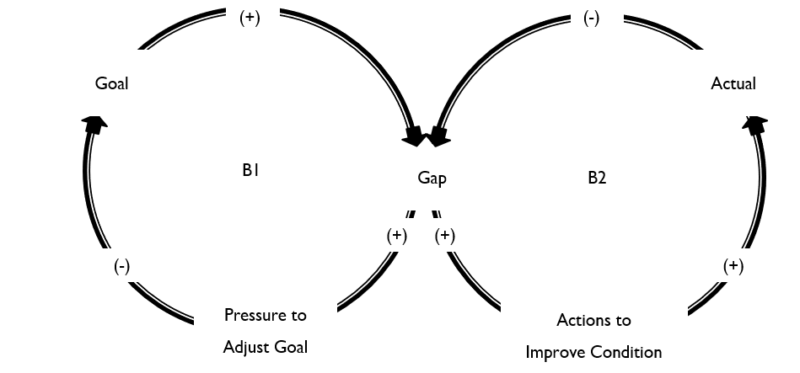
3. Eroding
Goals
Similar to Shifting the Burden because again there is a desire for a short-term fix. But here we allow ourselves to adjust our goals, so we are now able to live with the problems. We decide that we simply cannot do what needs to be done and settle for a lesser goal.
This creates a culture of inferior achievement in the organization, since goals are uniformly discredited and never truly pursued.

Slide 15
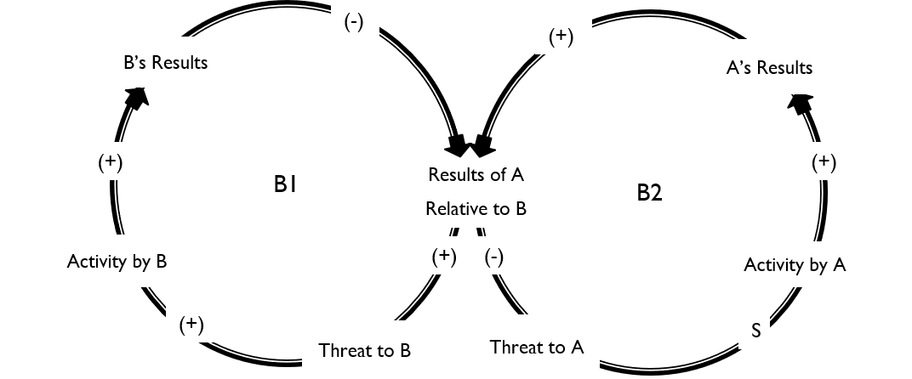
4. Escalation
Escalation can be found anytime there is strong competition in a marketplace.
Each investment by Company A is seen as a threat by Company B, which in turn increases its own investment level. Company B’s investment is seen as a threat by Company A…and the cycle continues. One company may win, but both may also lose.
Leverage is found in differentiation.

Slide 16
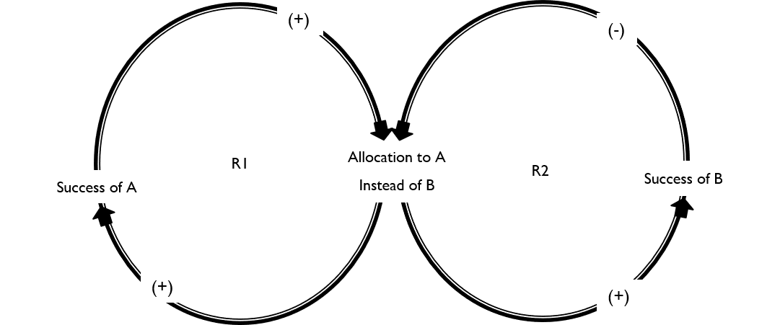
5. Success to the Successful
This Archetype describes the practice of rewarding for results. The problem arises when the underperforming area is not given the resources necessary to perform as needed since the resources are given elsewhere.
The oversight occurs when we forget that resources help the successful get that way in the first place, and that the two are linked.

Slide 17
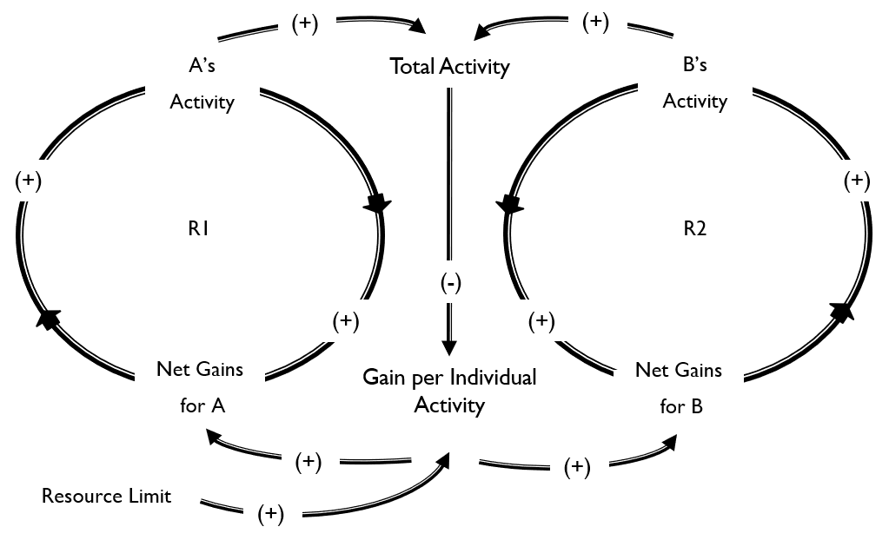
6. Tragedy of the Commons
This Archetype describes how resources that are made available to everyone (the Commons) can be stressed to the point of breaking. The organization is unaware of the demands placed by so many on the Commons, so demands are left unchecked.
Leverage is gained by understanding the systems view and seeing where demands can be alleviated.

Slide 18
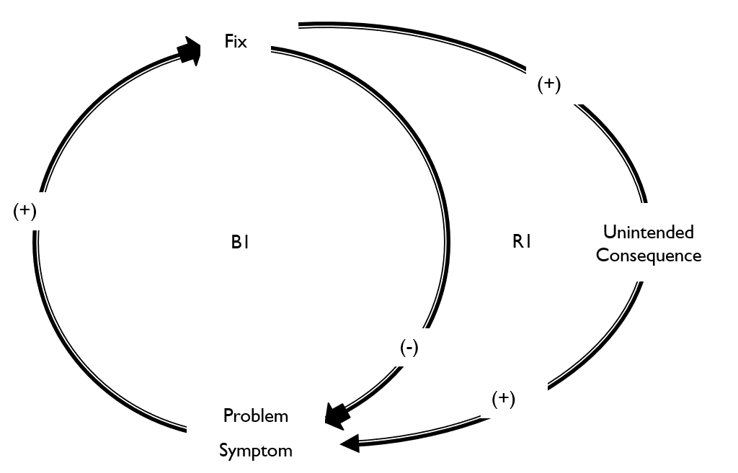
7. Fixes that Fail
Again, we see how a symptomatic solution is chosen over a systemic solution, but this time there are unintended consequences that keep us from experiencing at least some palliative relief.
The unintended consequence of our actions exacerbates our initial problem, adding more problems and confusion to the situation.

Slide 19
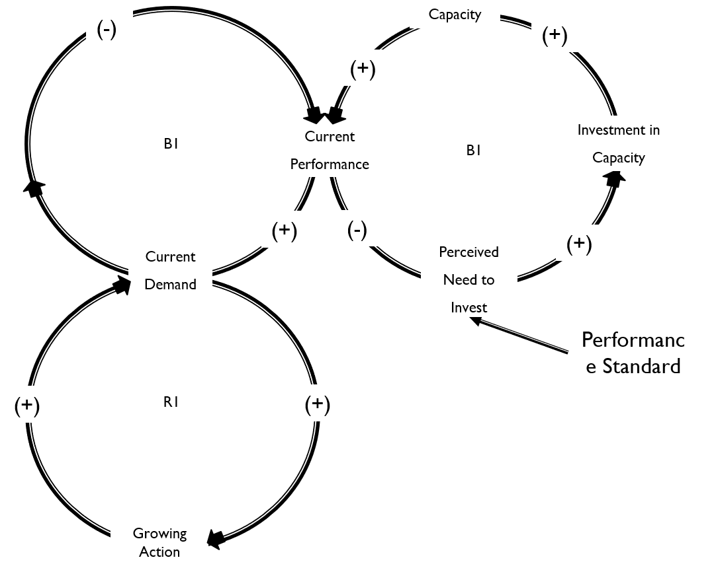
8. Growth and Underinvestment
Similar to Limits to Growth in that the org. is trying to grow without addressing the limiting factor. Without the investment needed, the company sees a drop in demand, which fuels the speculation that more investment is not needed.
Many people ask, “why throw good money after bad?”
Example: in private practice, doctors have to decide between pulling money out of the practice or re-investing it.

Slide 20
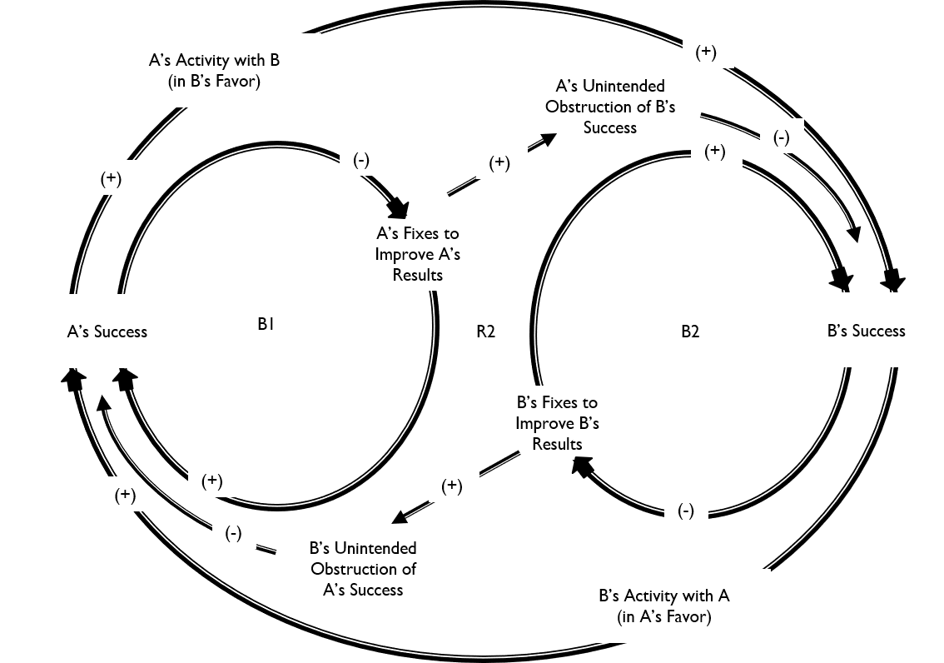
9. Accidental Adversaries
This Archetype evolves in much the same way that Escalation does, but it starts differently. In the beginning, there is no competition between the two companies. Then Company A does something that Company B feels threatens their market share, so they feel inclined to retaliate.
The leverage is to learn how actions are seen by others, and to recommit to shared ideals.
R1

Slide 21
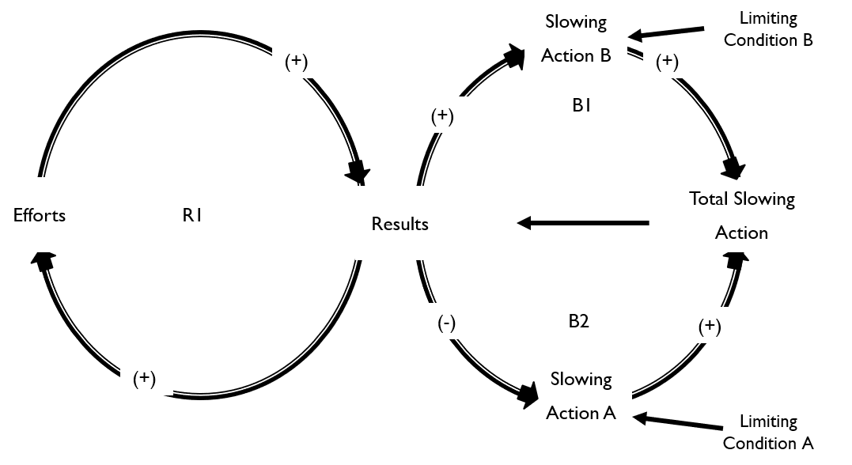
10. Attractiveness Principle
In this Archetype, the growing action is subject to multiple slowing actions, each one representing an opportunity and an opportunity cost. The manager has to decide which one is the most attractive to pursue.
The leverage is utilized when the manager realizes that many of these can be fixed at once if he finds the root cause and pursues a systemic fix instead of symptomatic one.

Slide 22

Contact information
www.leanenglishconsulting.com
info@leanenglishconsulting.com
https://www.linkedin.com/in/thomas-sicola-8a331135/
12 Route du Conquet
29280 Plouzané, France
Notes:
Well, that brings this episode to an end. Congratulations, you made all the way through. I’m proud of you. You didn’t give up, no matter how boring it became. Here is our website and email addresses. And here is my LinkedIn profile if you want to learn more about me and my experience.
Drop me a line and let me know if there is a subject that you would like me to cover in future episodes. “Drop me a line” means send me a note or email. Or leave a response in the comments. I would love to hear from you. If you need a little help following along, you can find a full transcript of the podcast on my website, leanenglishconsulting.com. Now, I write and produce all my podcasts by myself, and this is my own voice. It is not AI. So hit the like button and subscribe if you feel so inclined. I greatly appreciate it. Well, that’s it for today. I’ll talk to you later.

